Slide 1
Unity Up
Lebanese Youth Organization
Solidarity In Diversity
ONE LEBANON, ONE HEART

Slide 2
Our Mission
Empower People to build a better and sustainable future for Lebanon and the World

Slide 3
Our Core Objectives
Enhancing the Capacity Building of Youth
Promoting Peace And Development
Promoting The Solidarity in the Diversity
Building Bridges on the National &International Levels
Environmental and Education Awareness

Slide 4
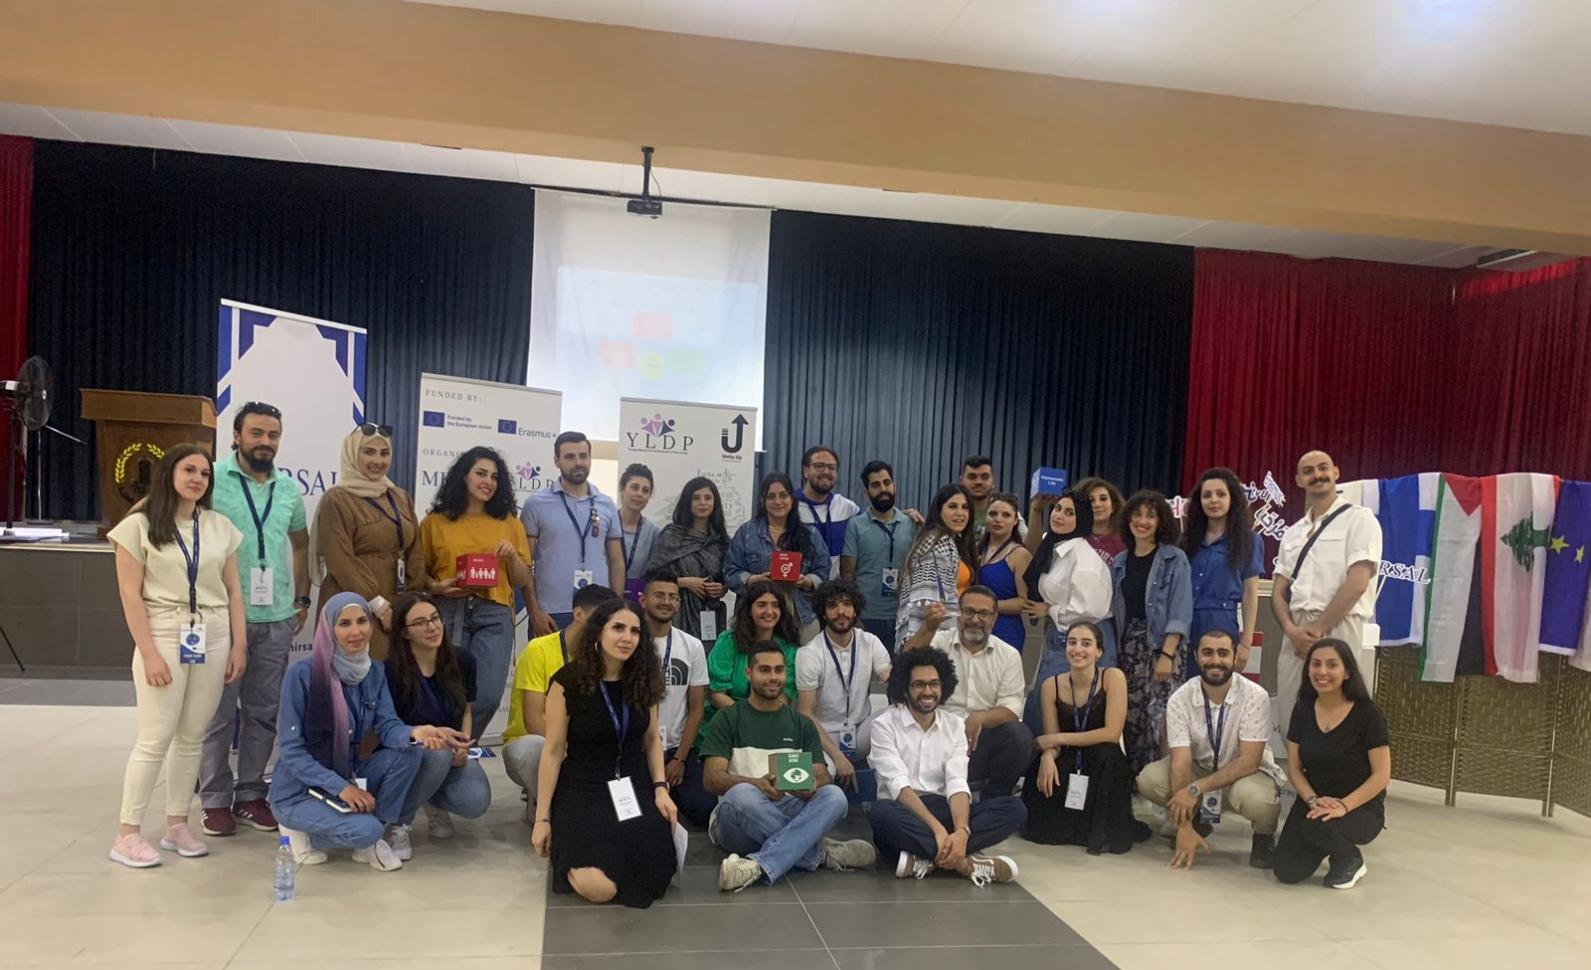
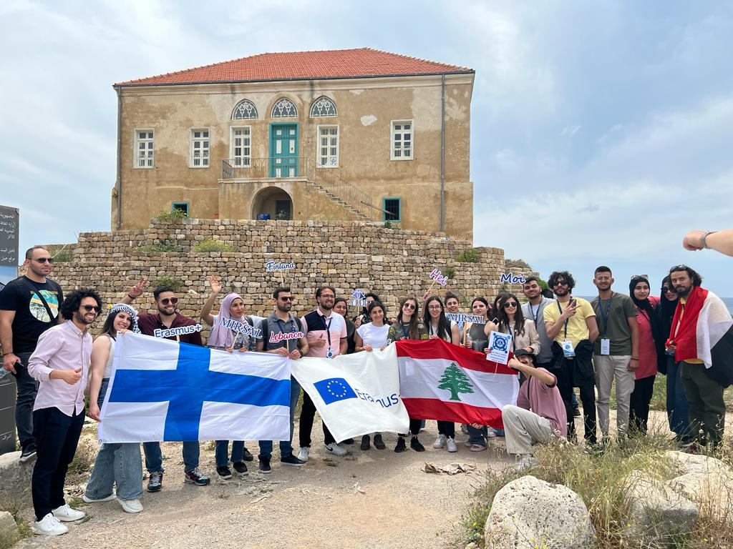
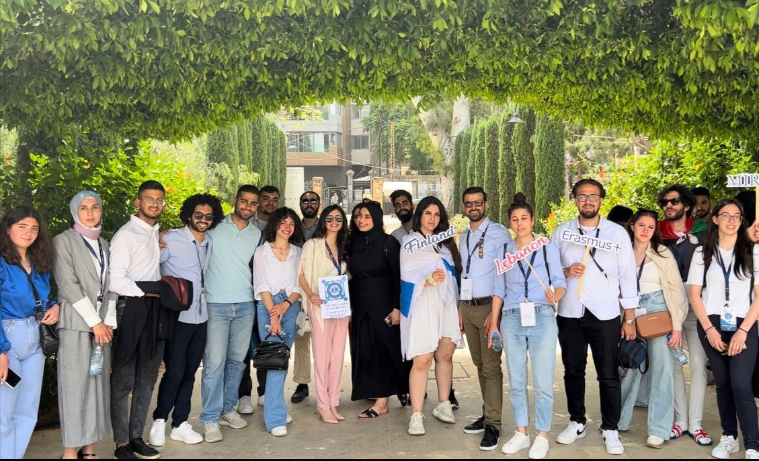
Me And You Are Global Citizens Erasmus Plus Project Leb- Fin
Young Lebanese For Development And Peace YLDP Group

Slide 5
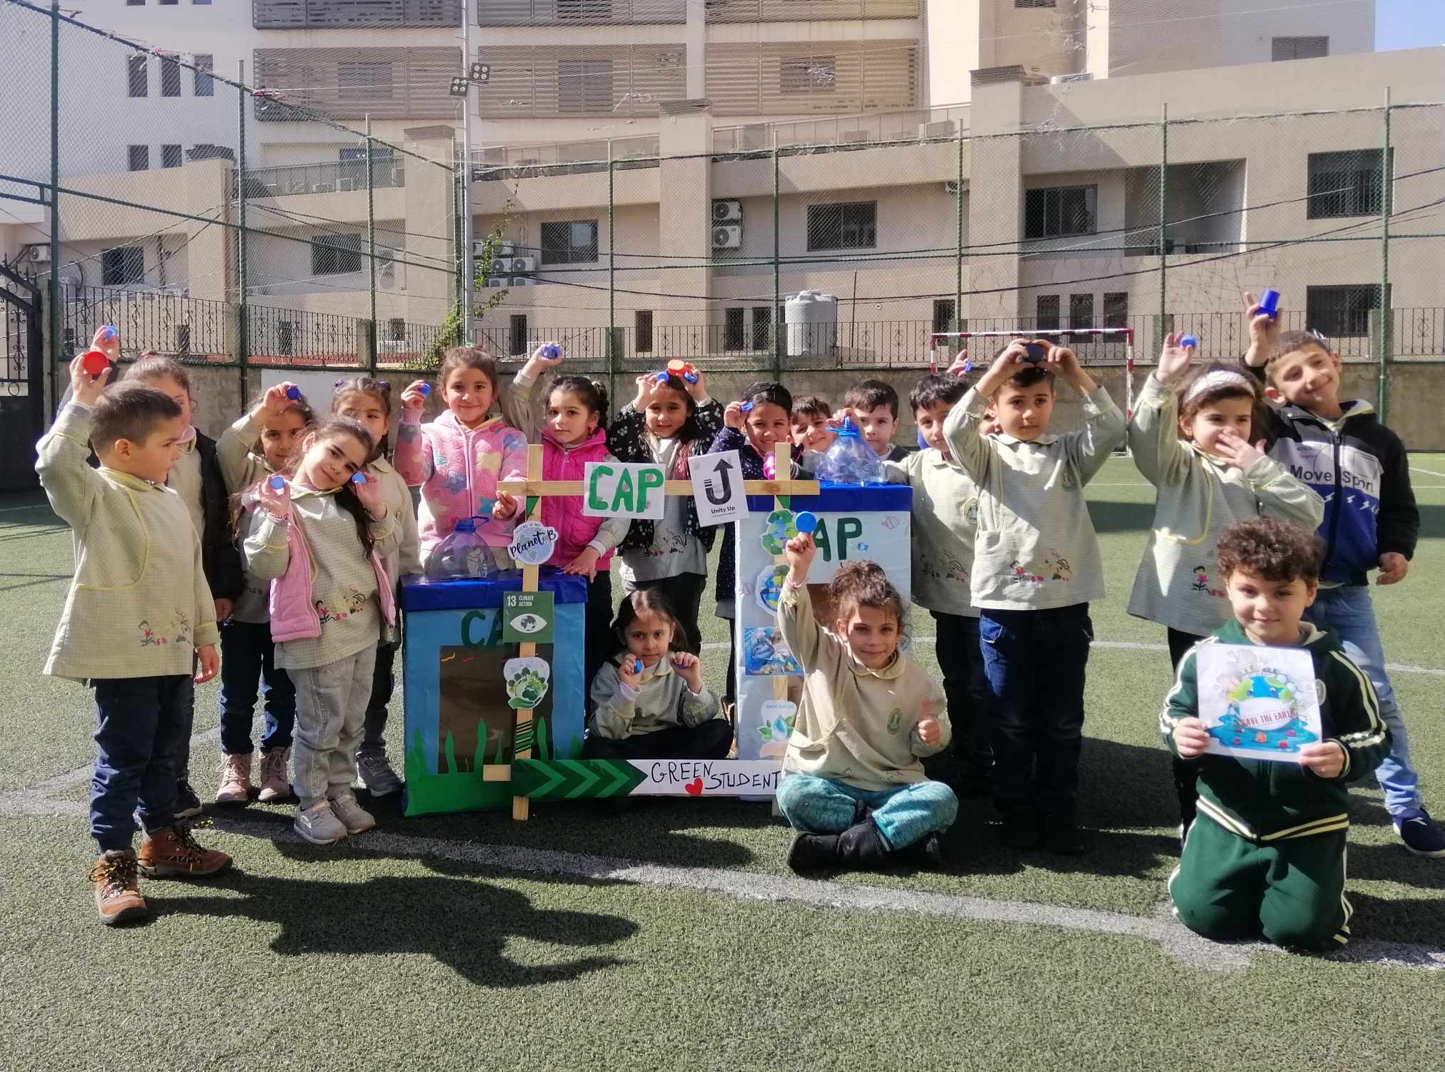
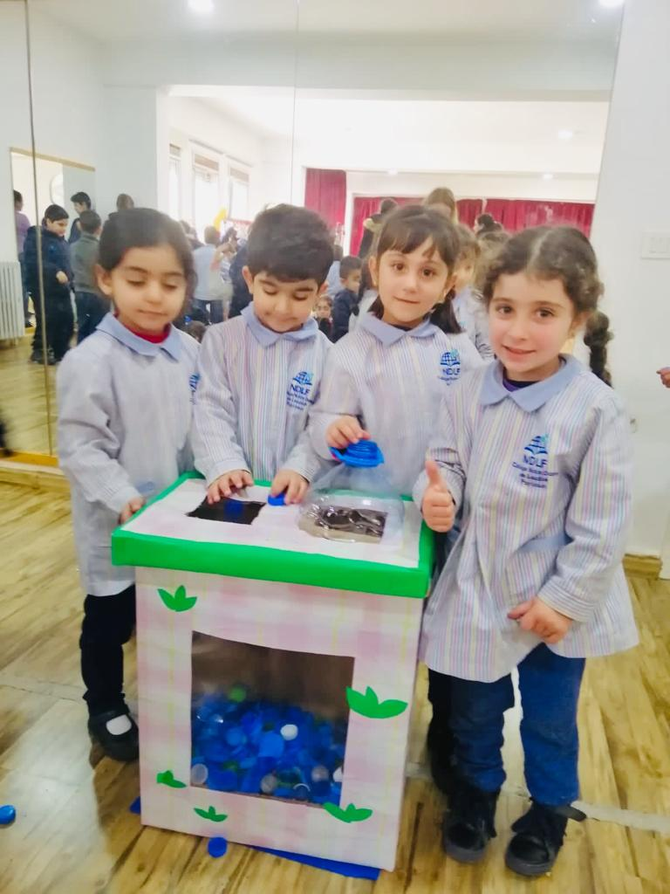
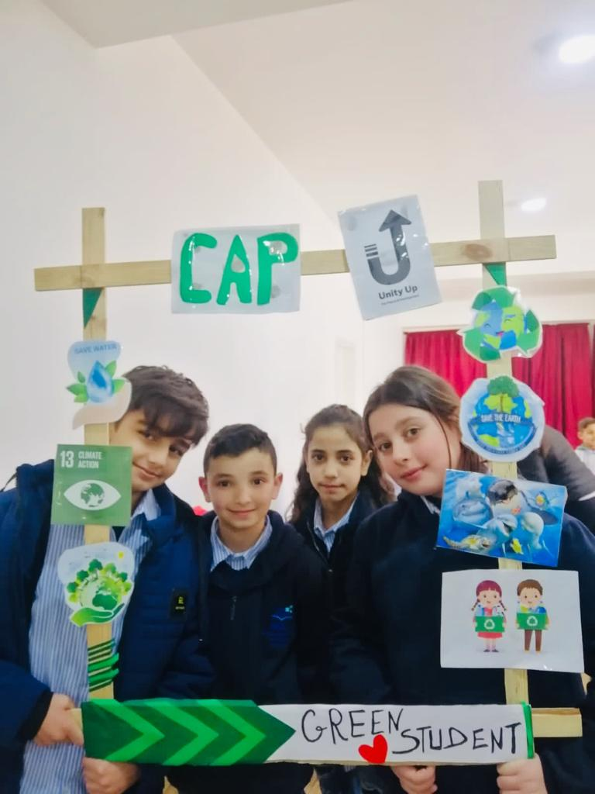
Community Against Pollution CAP Project

Slide 6
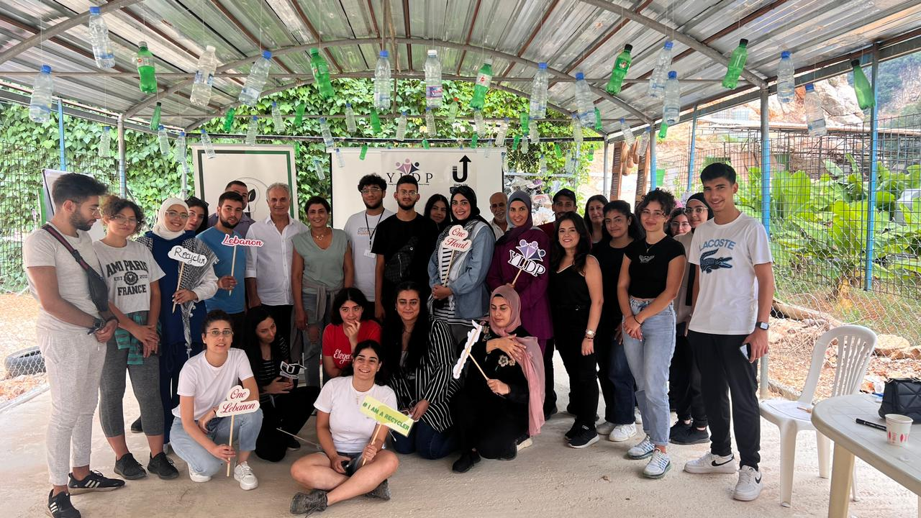
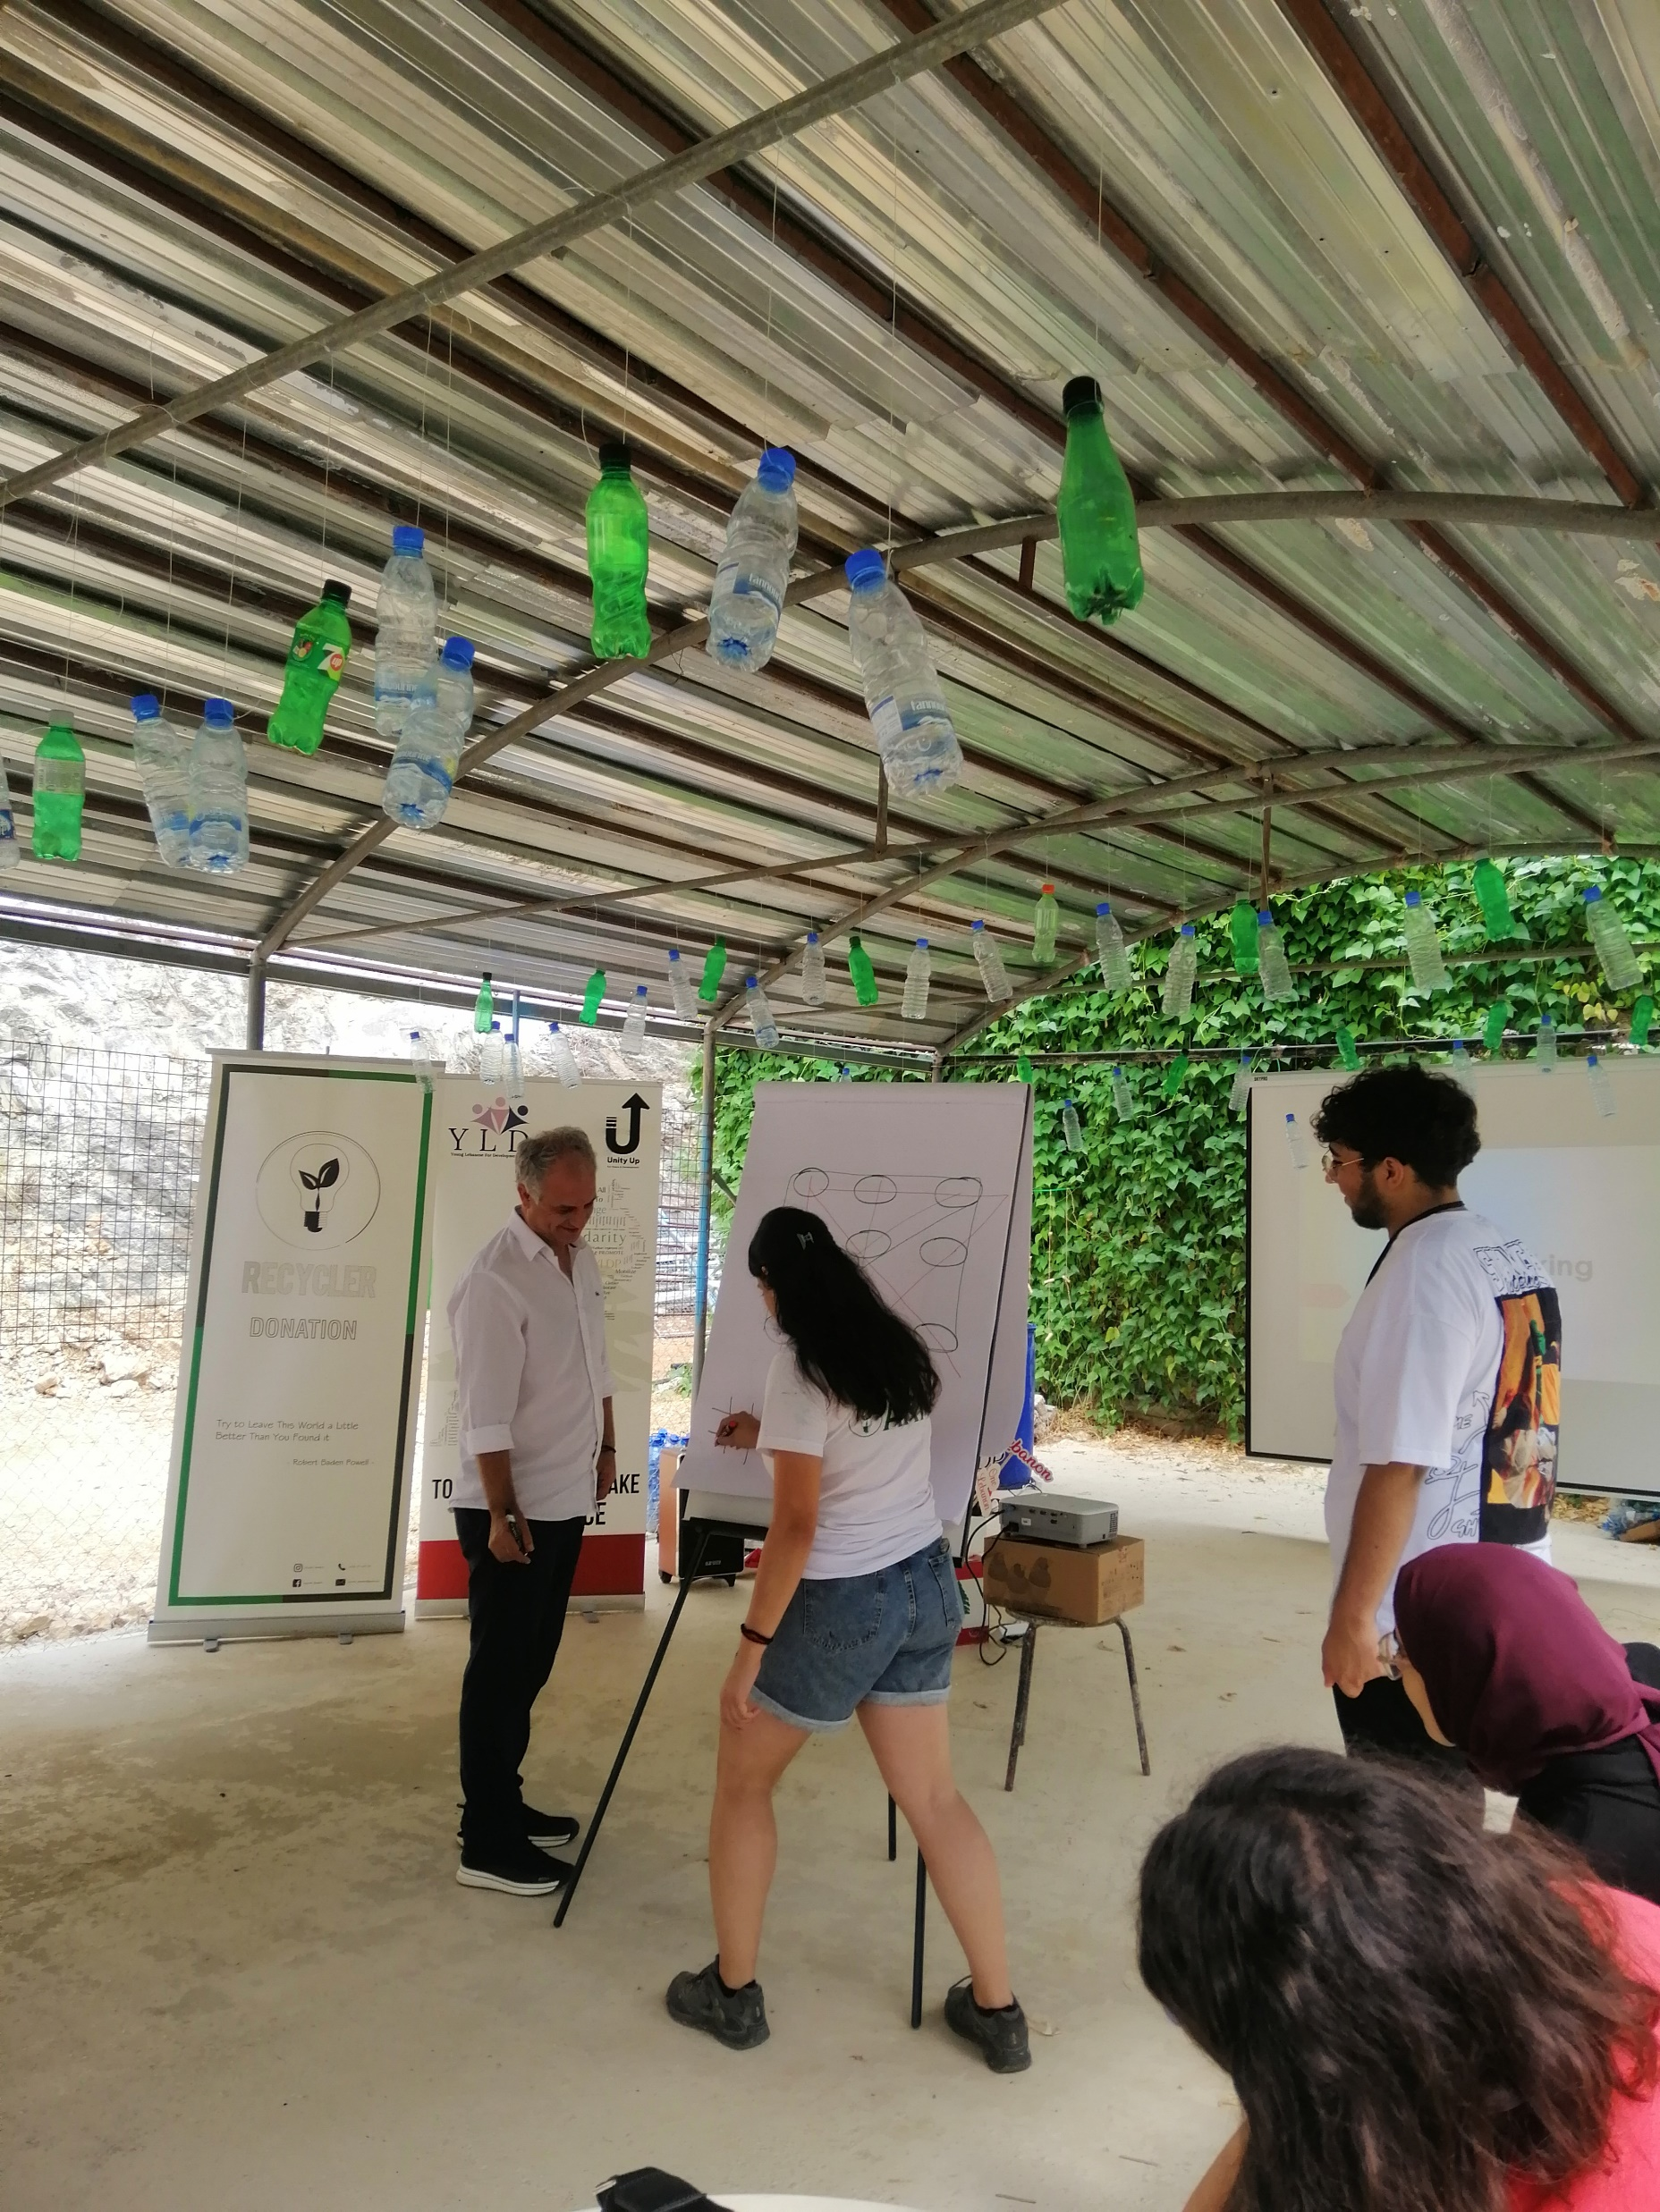
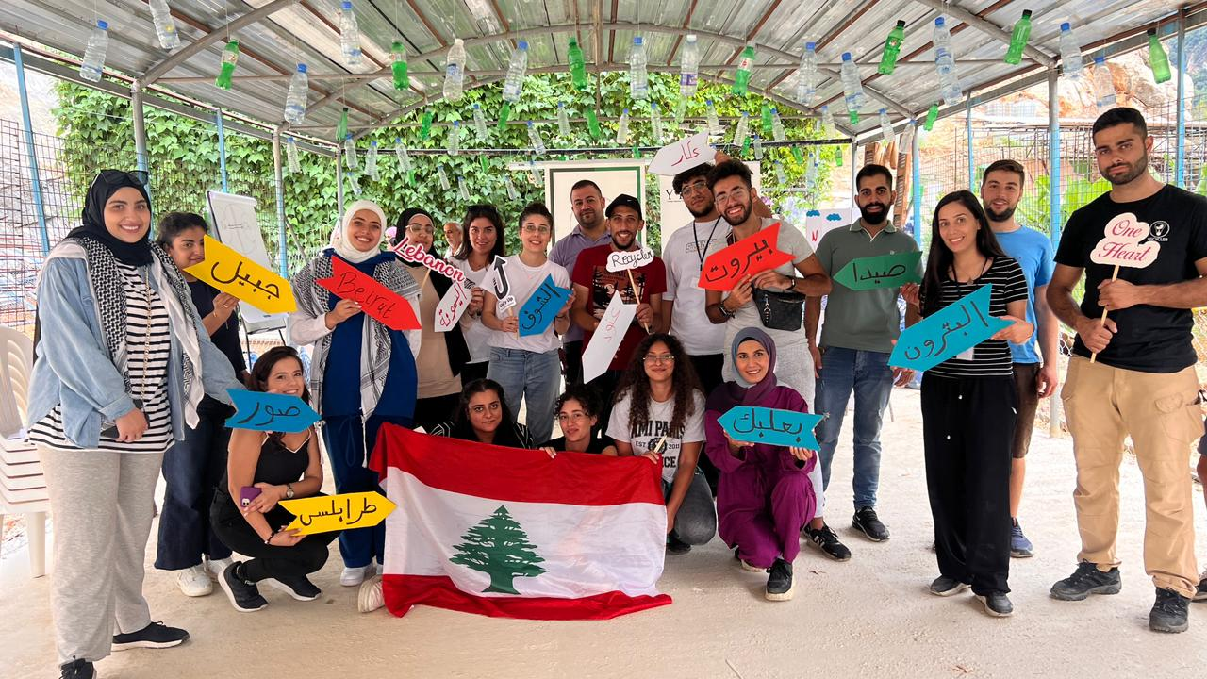
Lebanese Citizenship Across Regions National Exchange Project

Slide 7
Unity Up
Follow us on our pages: Facebook : Unity Up Instagram : Unity Up Leb LinkedIn : Unity Up
Thank you!

